Slide 1
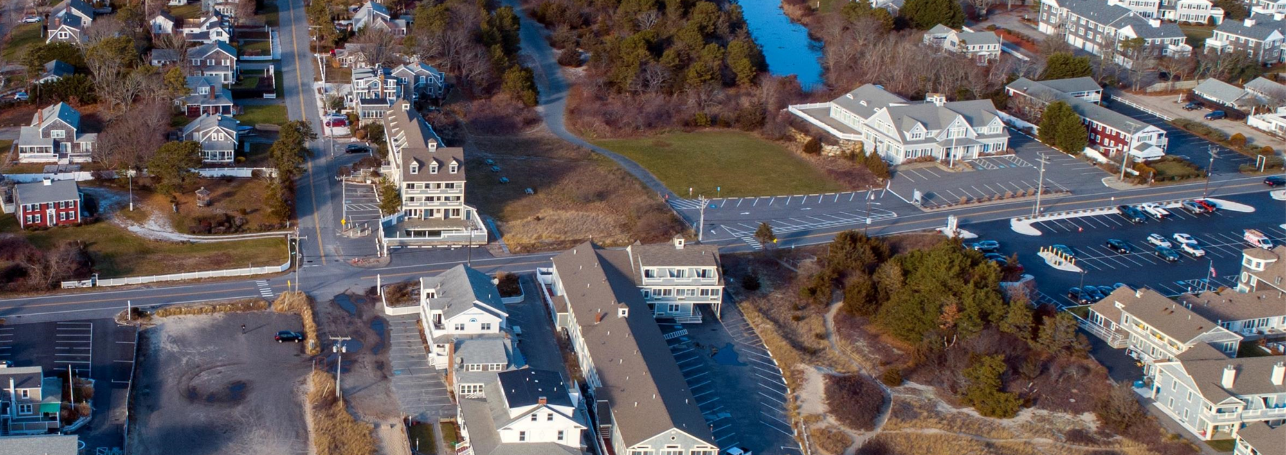
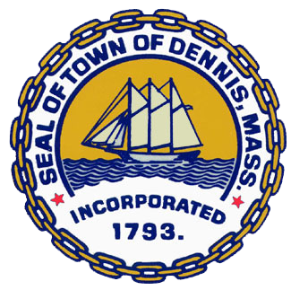


Dennis Pound Pond: Resilient Stormwater Design Project Update
Coastal and Climate Resiliency Committee
July 20, 2023
Gabrielle Belfit, CFM, Tighe & Bond
Troy Barry, PE, Tighe & Bond
Tom Andrade, PE, Dennis Town Engineer
Notes:
Provide an update on Carver’s ongoing stormwater management program
Major Permit Year 5 accomplishments
Focus on deliverables for a FY23 BBNEP Grant Task which are aimed at reducing stormwater pollution from the Towns municipal prosperities and a review of the Town bylaws for parking lot design and green infrastructure.

Slide 2
Dennis Pound Pond: Resilient Stormwater Design Project Update -AGENDA
MVP Grant Funding- FY22-24
Project Need- Restoration Goals
Project Design- Improving hydrologic function and resiliency utilizing wetland riparian restoration
Alternative Amenities- Passive Recreation, Habitat Enhancement
Public Outreach
  GIS Storymap
  Education Kiosk Design

Slide 3
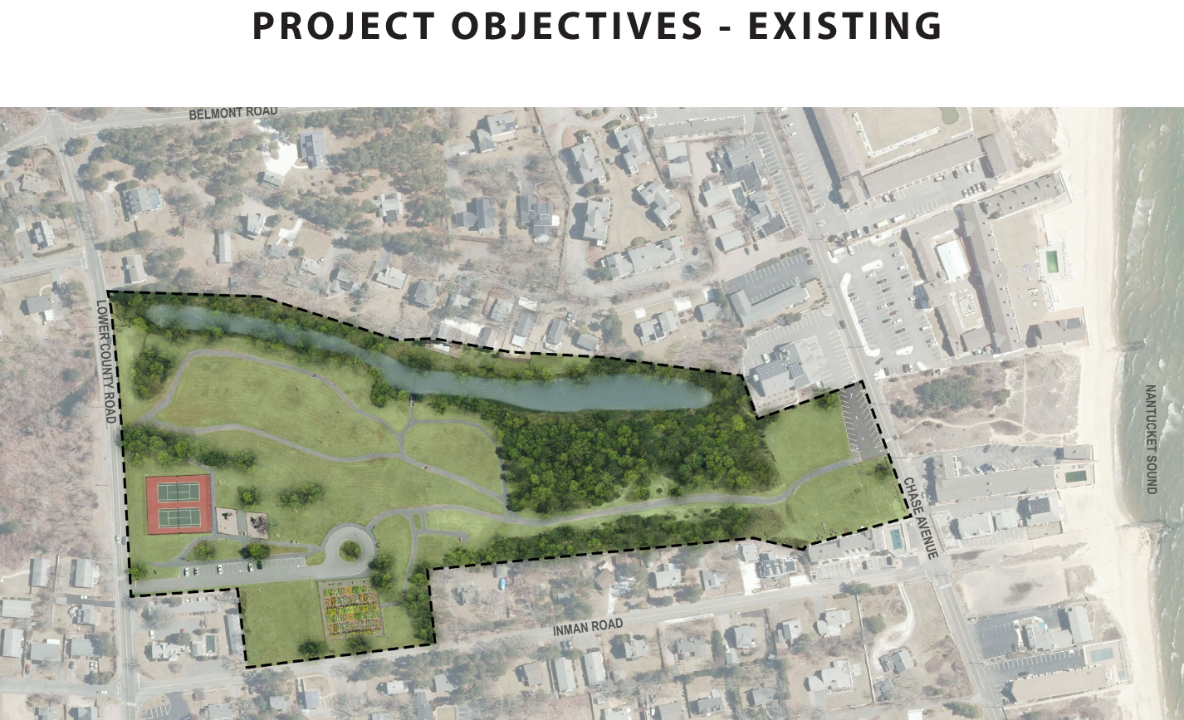
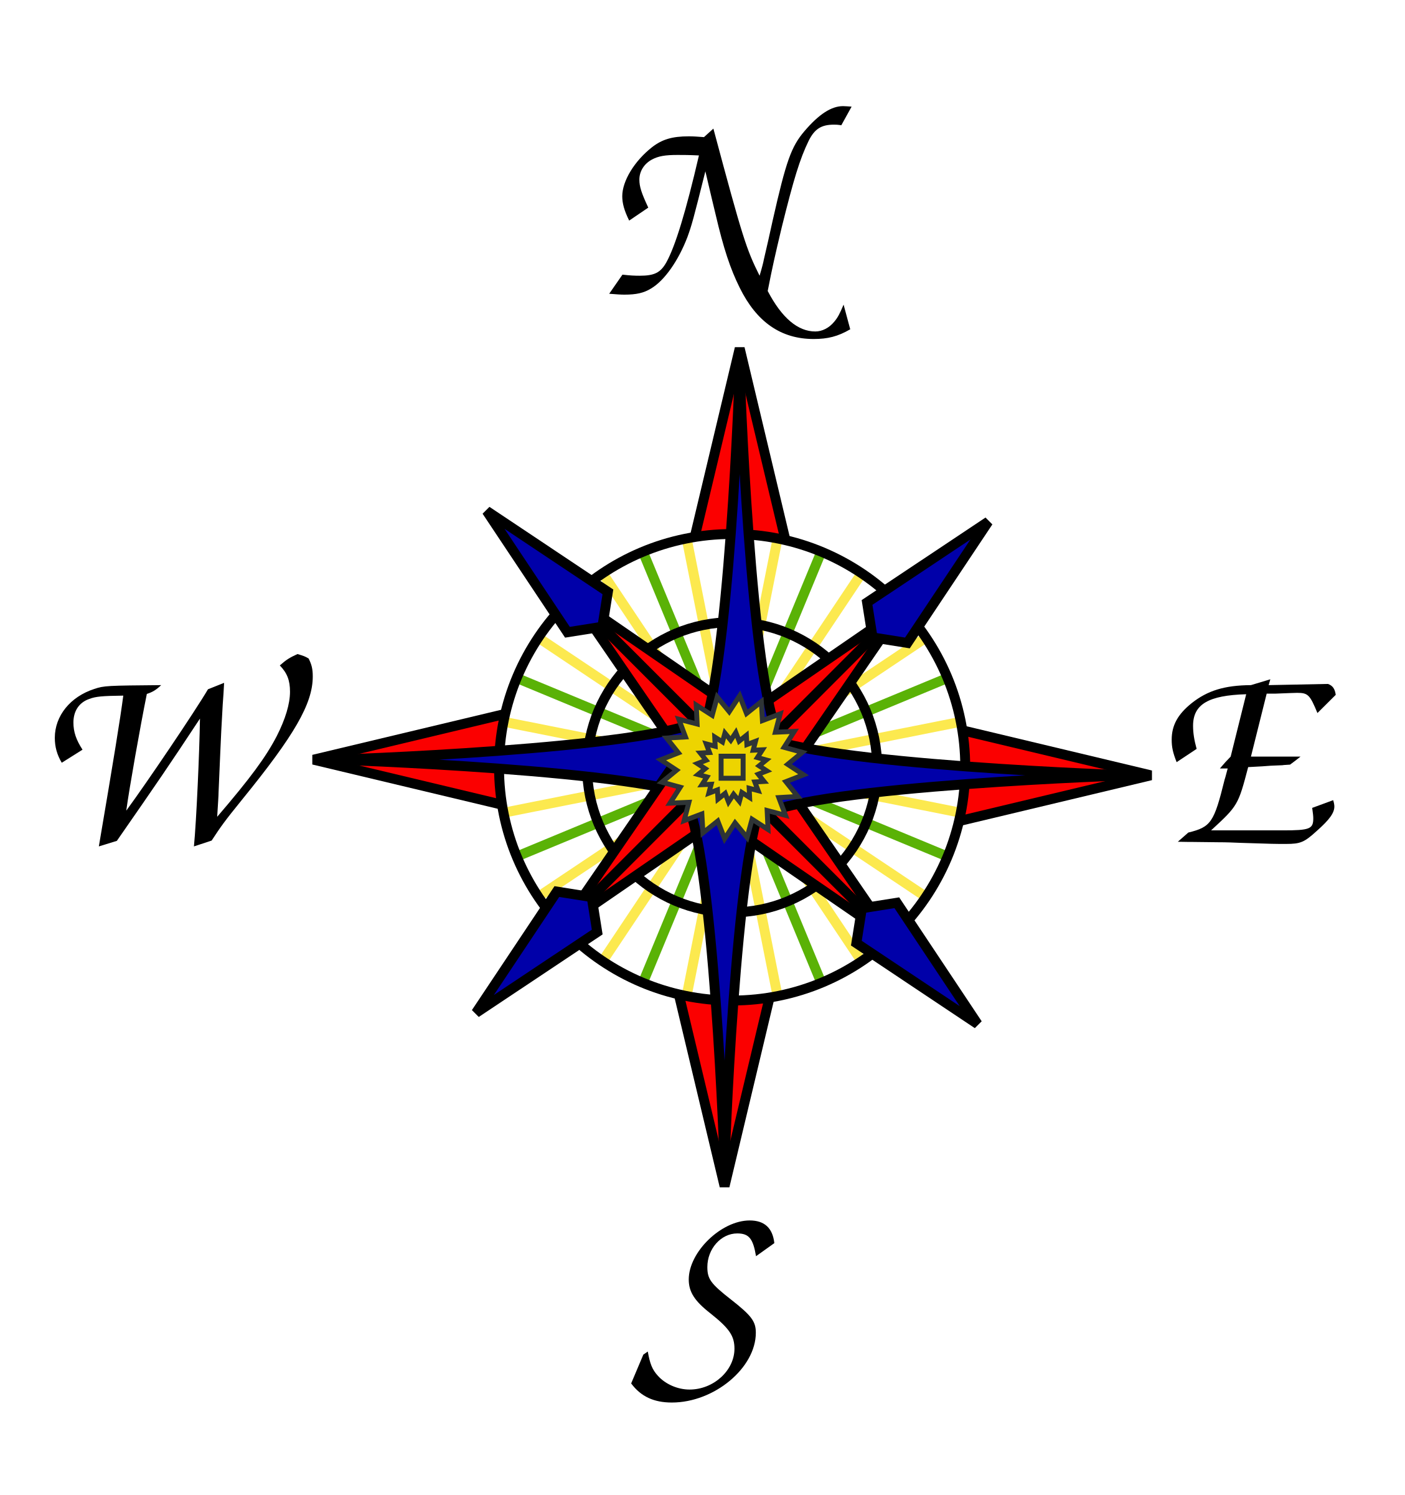
Welcome to Pound Pond
Nestled between the historic village of Dennisport and the South Cape beaches along Nantucket Sound, Pound Pond has survived 18,000 years of change.
Geologic processes in the Pleistocene Epoch and more recent anthropogenic uses have shaped Pound Pond over the years.
This historical knowledge is helpful to restore the Pond to its most vibrant, useful present.
Lower County Road
Chase Avenue
Nantucket Sound

Slide 4
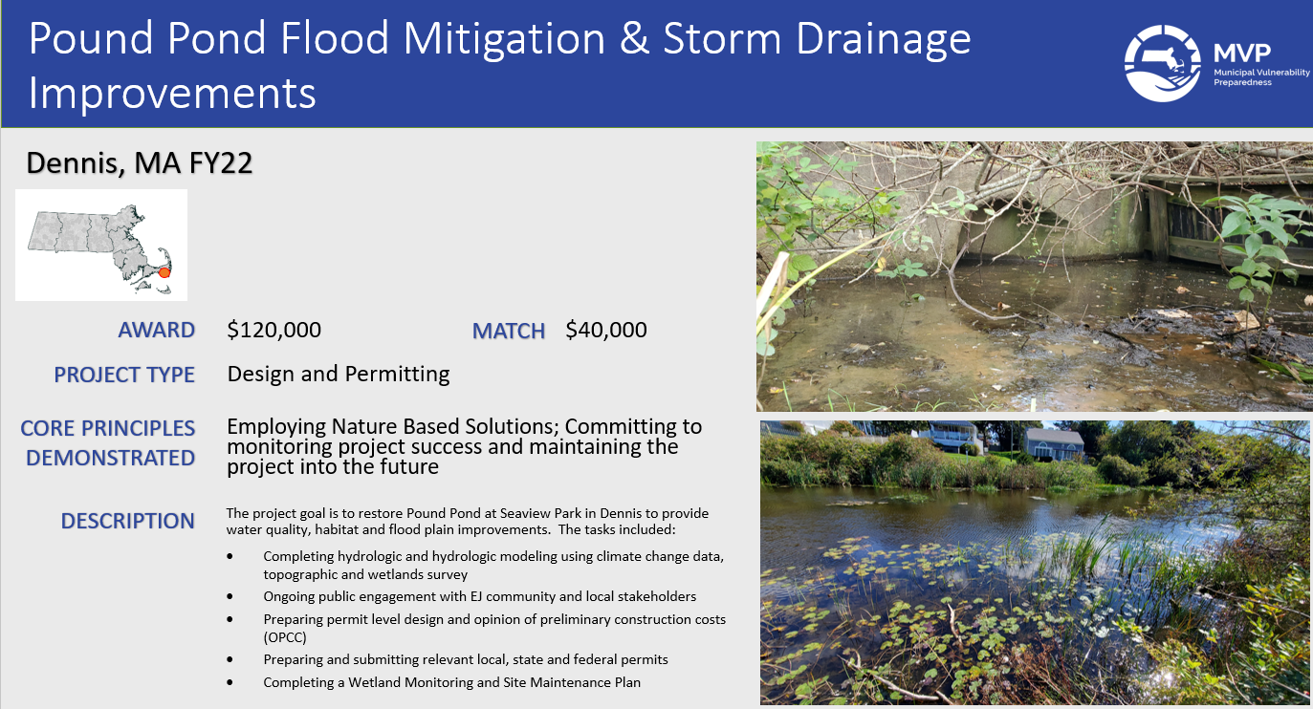

Slide 5
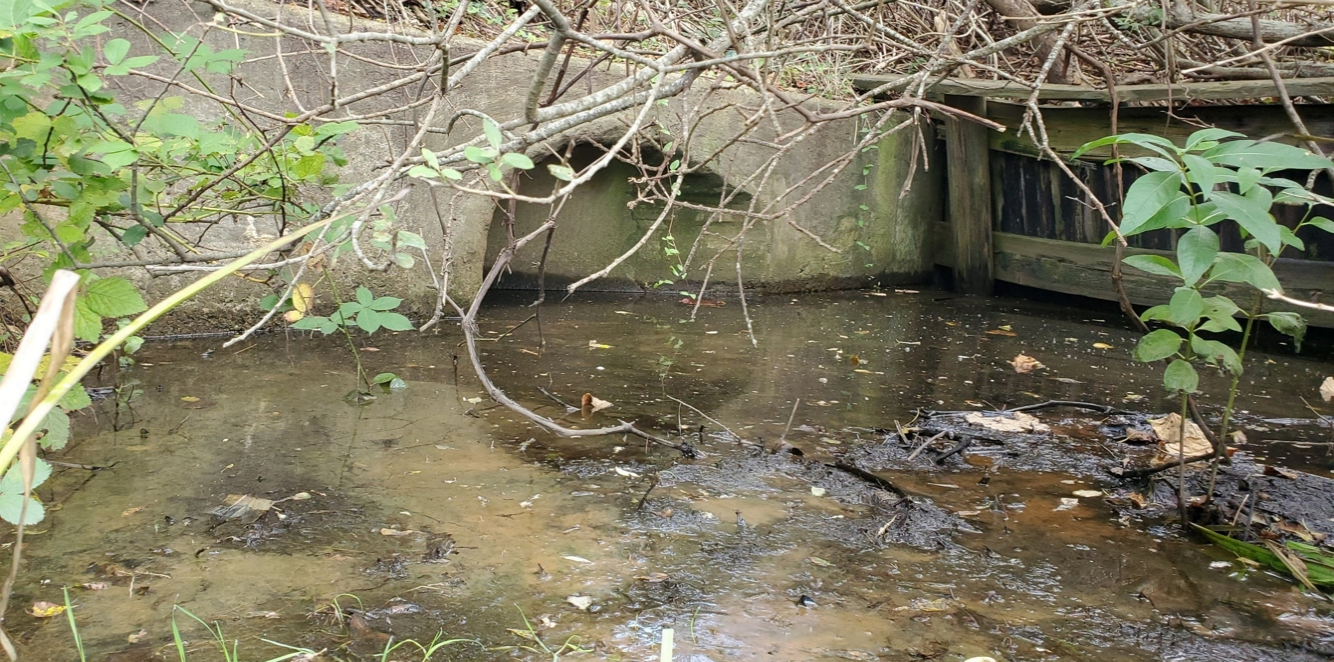
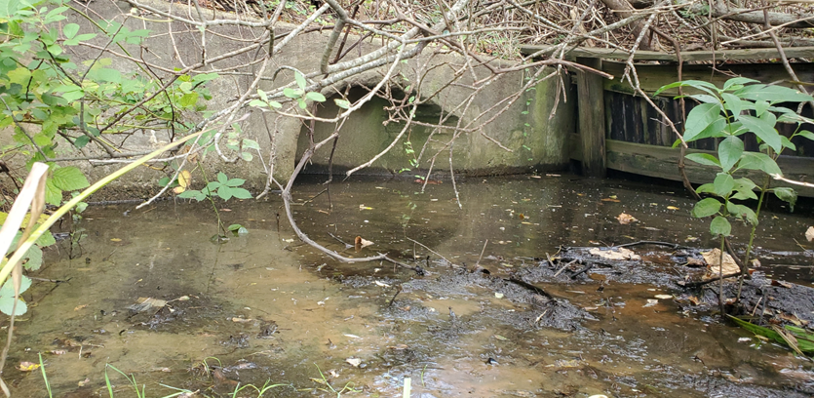
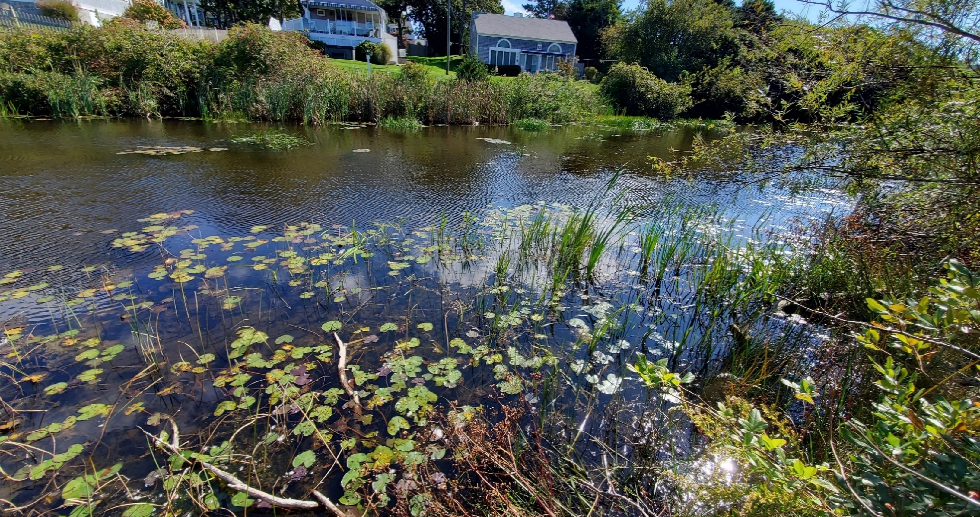
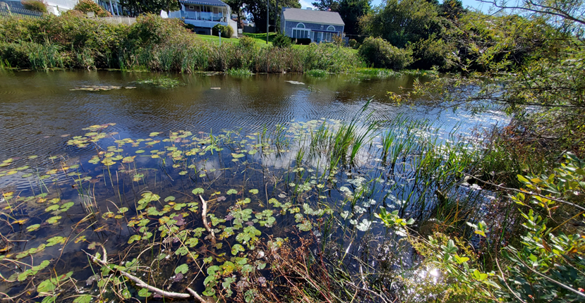
Pound Pond Flood Mitigation & Storm Drainage Improvements
Dennis, MA FY23/24
$73,628
$24,542
Final Design
Employing Nature Based Solutions; Committing to monitoring project success and maintaining the project into the future
FY23/24: Finalize permitting and design, and expand the community outreach and engagement component of the project
  Public Meeting, GIS Story Map, Kiosk Graphics
  Permitting – Chapter 91, USACOE, CZM
  Final Design, Budget, and Technical Specifications

Slide 6
Future Climate Change Impacts & Vulnerabilities
Increased flooding due to rising sea levels
Intense coastal storms
History of Flooding
1944 Flood
1954 Hurricane
Historic Causes of Degradation
Stormwater runoff
Sedimentation
Invasive Species
Restoration and Resilience Plan

Slide 7
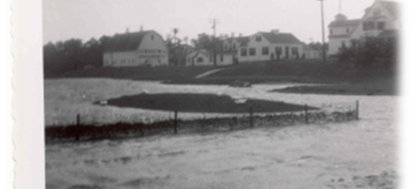
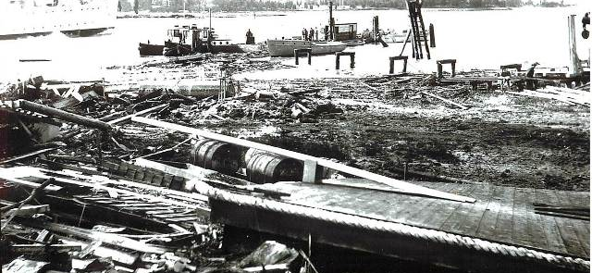
History of Flooding
Over the centuries, Pound Pond has been flooded on several occasions notably in 1938 by the Great New England Hurricane and in 1954 by Hurricane Carol.

Slide 8
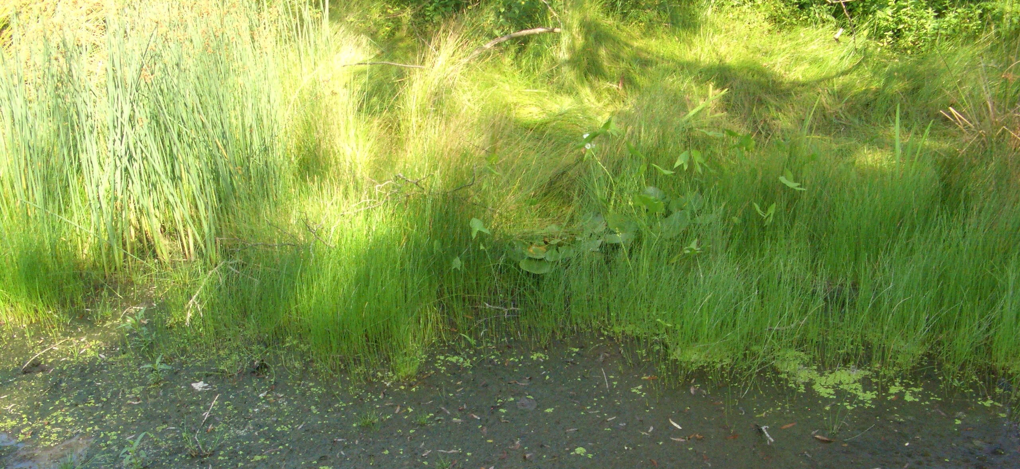
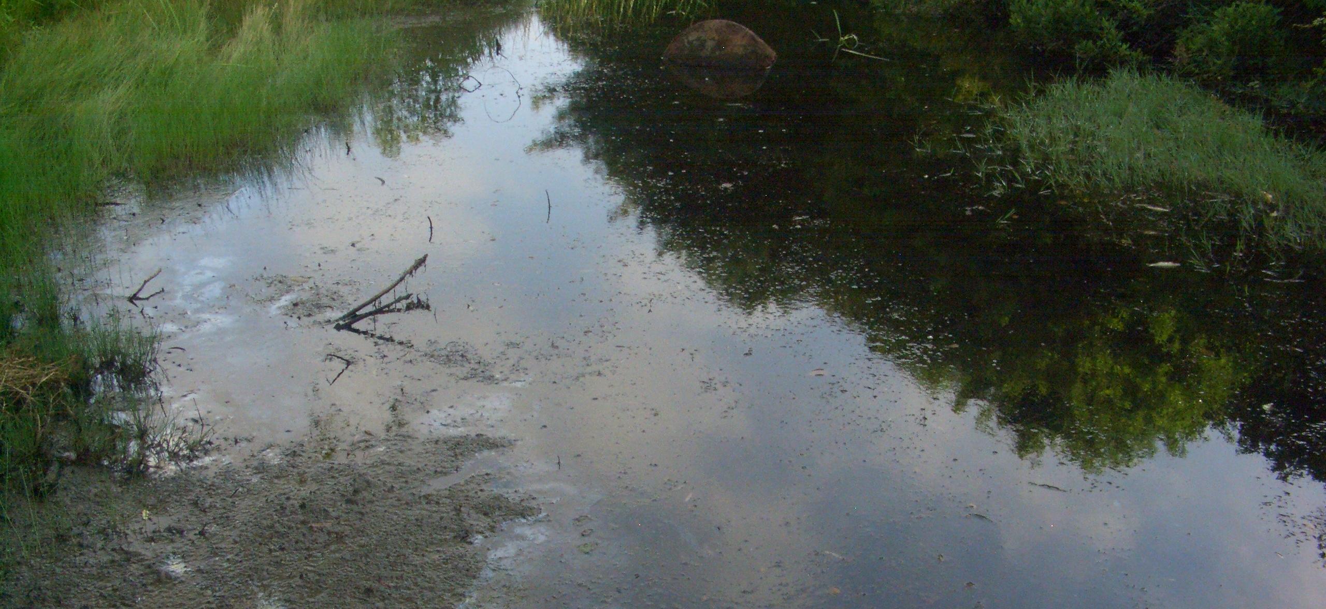
Historic Cause of Degradation
Over the centuries, Pound Pond was altered from a native freshwater wetland to support a watering hole for livestock, cranberry production, paddle boats and miniature golf and a conduit for stormwater runoff from the more settled areas of Dennis Port.
The Pond has become impaired as stormwater runoff has channeled sediment, heavy meals, and pathogens through the watershed into Pound Pond.
Contaminants from runoff and erosion disturbances to the streambanks have set the stage for invasive plant species to colonize the degraded areas.
Contaminated sediment from storm runoff contributed to the loss of habitat and diversity of species.
Learn More: (https://www.youtube.com/watch?v=jNs28UcjNbk)

Slide 9
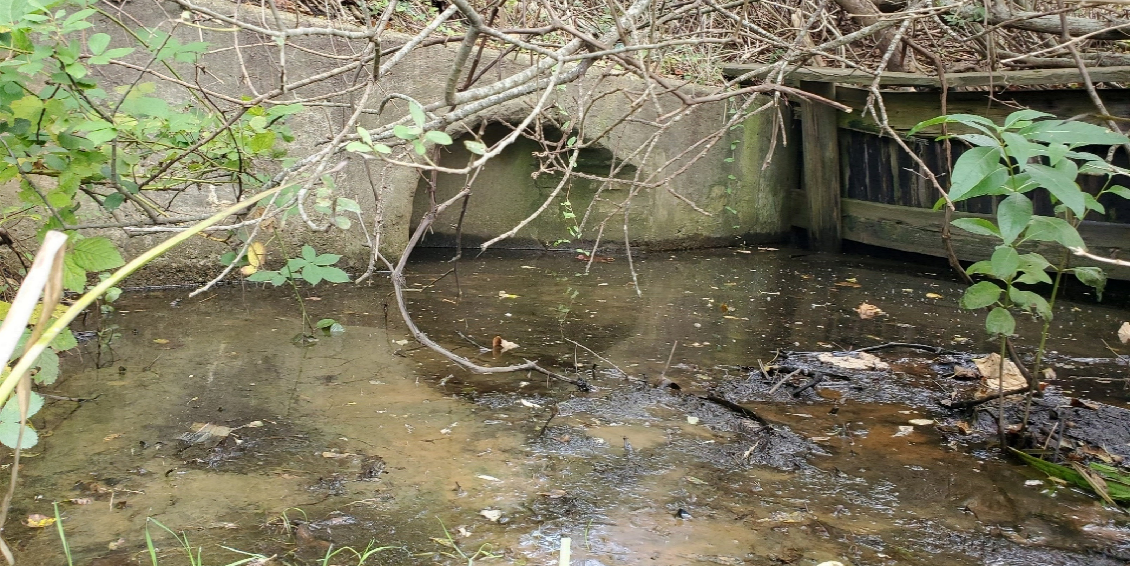
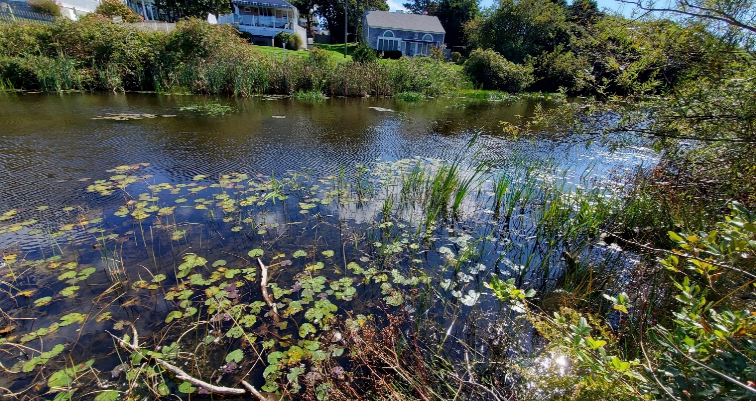
Restoration and Resilience Plan
Pound Pond faces water quality issues, including algal blooms, odor, and sedimentation. In addition, flooding is a secondary issue for the area which may become increasingly problematic in the future due to climate change.
Goals: Enhance stormwater mitigation, flood storage, and ecological functions and values
increase the size of the pond basin
daylight a portion of the culvert
improve stream flow
create new wetland habitats
provide bank stabilization and a vegetated buffer against erosion from pedestrians and storm-events

Slide 10
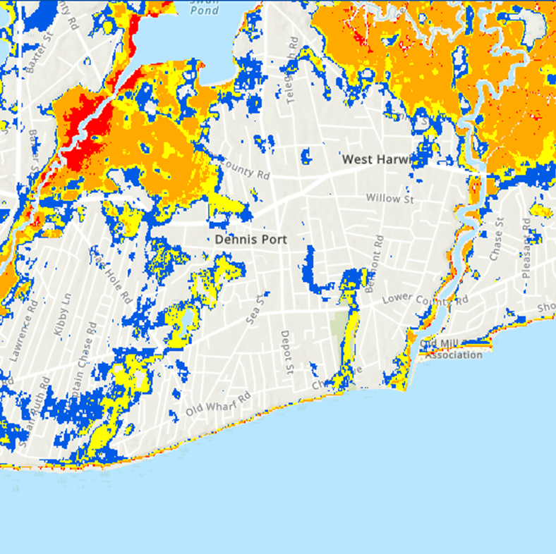
Future Climate Change Impacts and Vulnerabilities
Dennis is at risk of increased flooding due to rising sea levels, more intense coastal storms and increased coastal erosion. The project site is mapped within the NOAA Hurricane Storm Surge as well as the FEMA 100-year flood plain.
The Pond elevation is at 4-feet above sea level and is at risk from future inundation by the end of the century from sea level rise. According to State Climate Change data, sea level may rise as much as 4 feet by the end of the 21st century which could result in overtopping roadways and properties south of and including the Seaview park. Under this future scenario, Pound Pond would become a tidal embayment.
Storm Surge Risk Maps from NOAA show if Pound Pond is impacted by a Category 1 Storm (hurricane or tropical cyclone) it may result in flooding up to 3 feet above ground surface . A Category 2 Storm will result in flooding up to 6 feet and a Category 3 storm will produce flooding upwards of 9 feet. To experience more: https://experience.arcgis.com/experience/203f772571cb48b1b8b50fdcc3272e2c/page/Category-1/

Slide 12
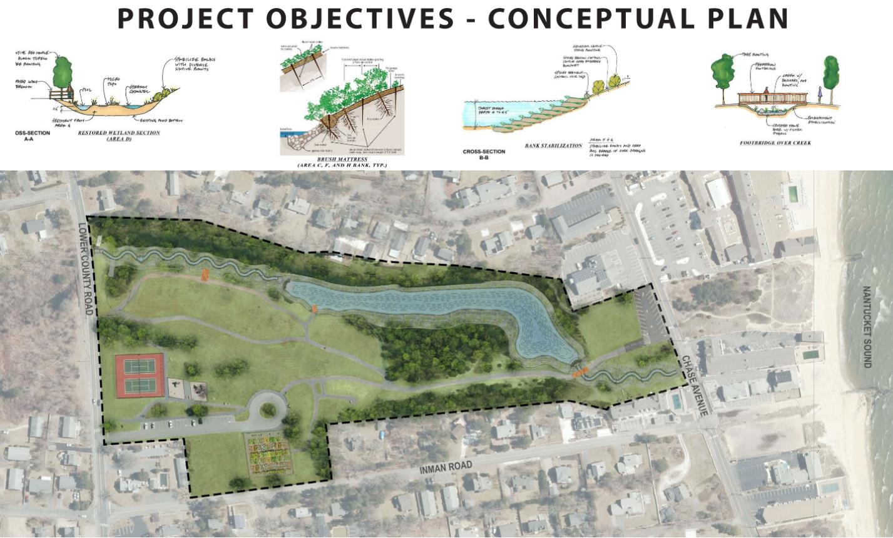

Slide 13
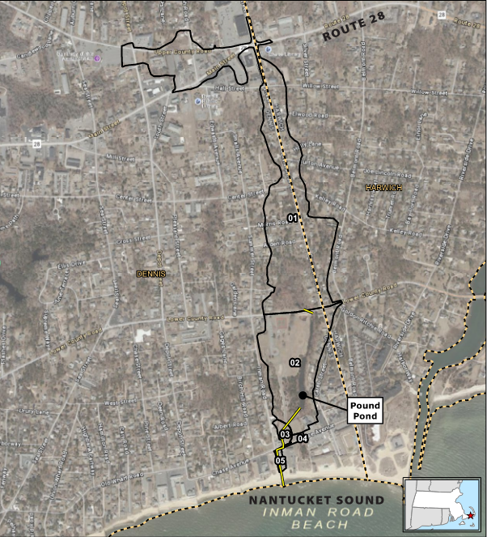

PROJECT OUTCOMES
  Resiliency Outcomes
    Water Quality Improvements
    Drainage Improvements
    Green Infrastructure
    Daylighting Stream
    Expanded Pond Volume and Benthic Structure
Watershed map with runoff

Slide 14
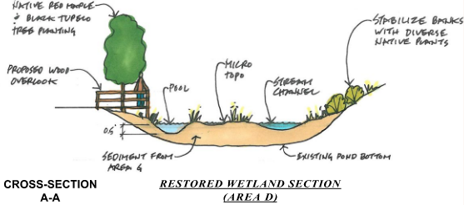

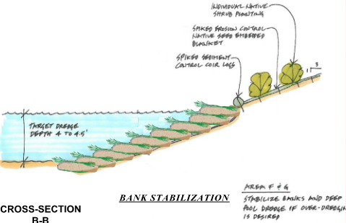
PROJECT OUTCOMES
  Ecological Outcomes
    Wetland Enhancement and Creation
    Supporting Wildlife Habitat & Diversification
  Resiliency Outcomes
    Bank Stabilization Normalizing Erosion
    Native Plant Communities for Habitat and Stabilization

Slide 15
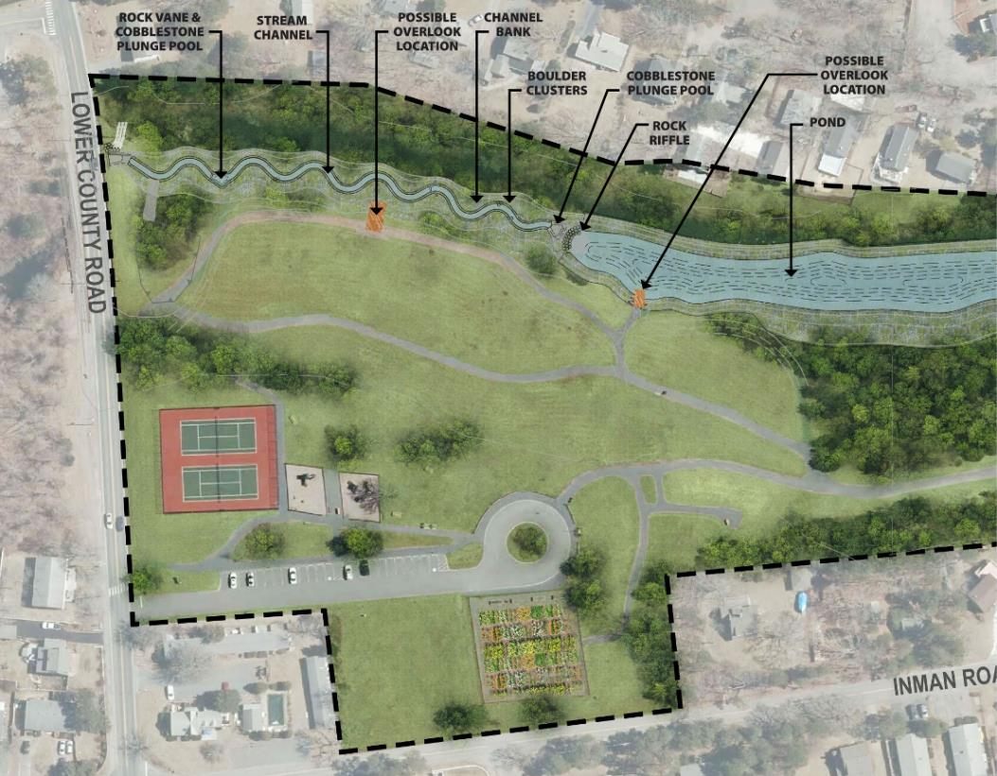
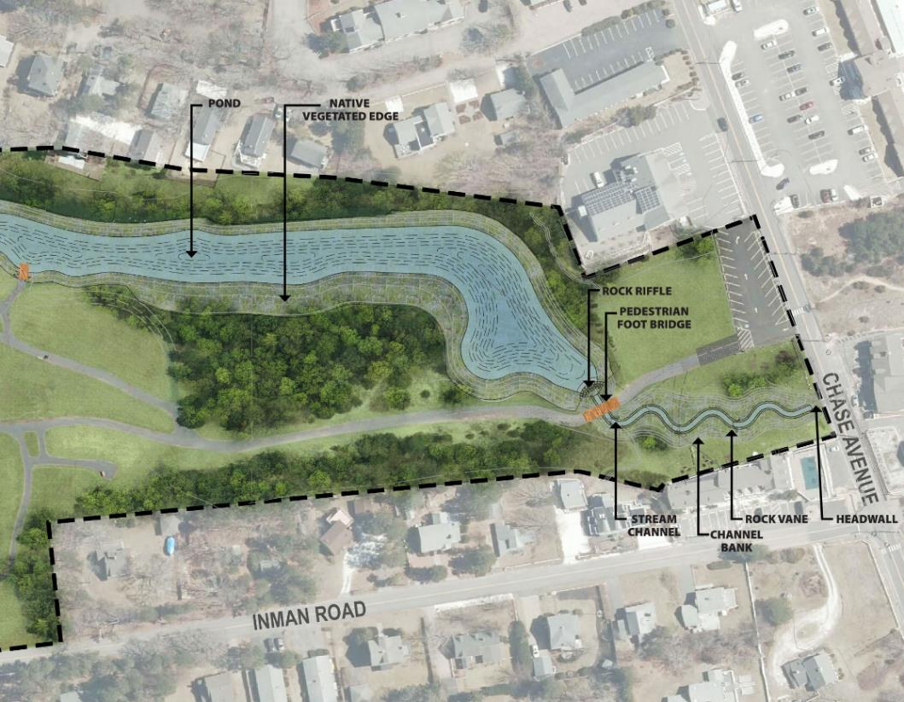
Proposed Conditions
  Stream Channel creating aeration
  Forebays for Stormwater maintenance
  Daylighting Stream Channel

Slide 16
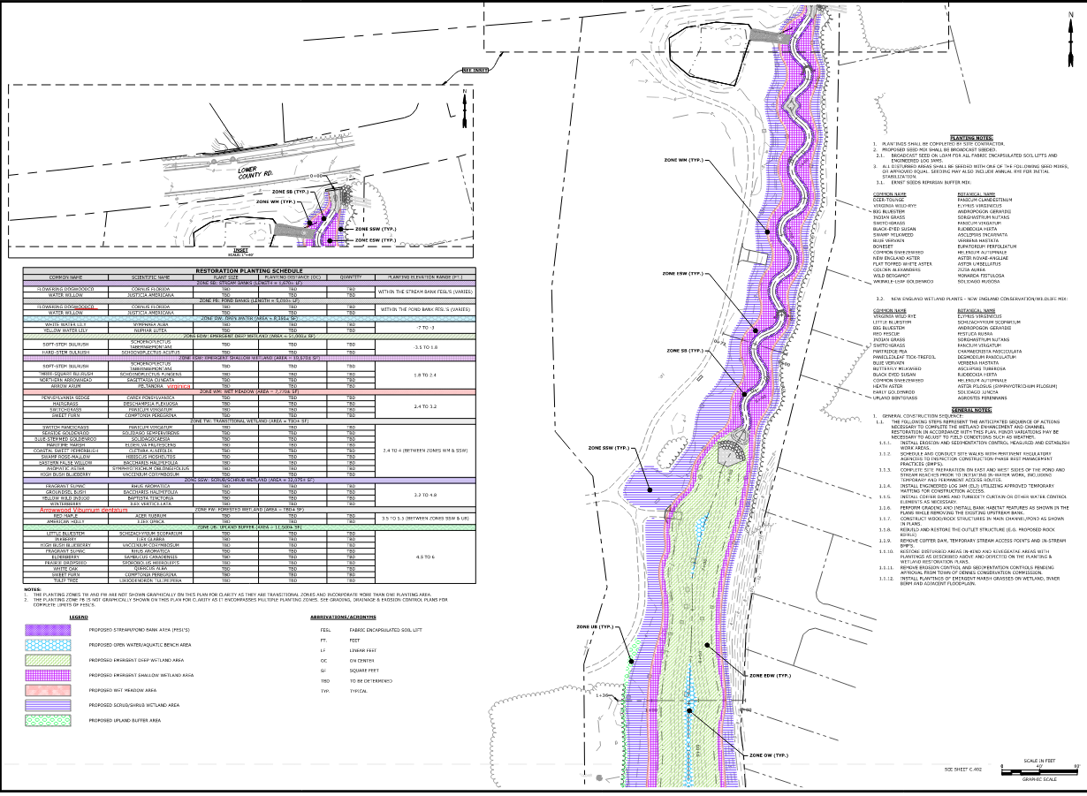
Planting Plan

Slide 17
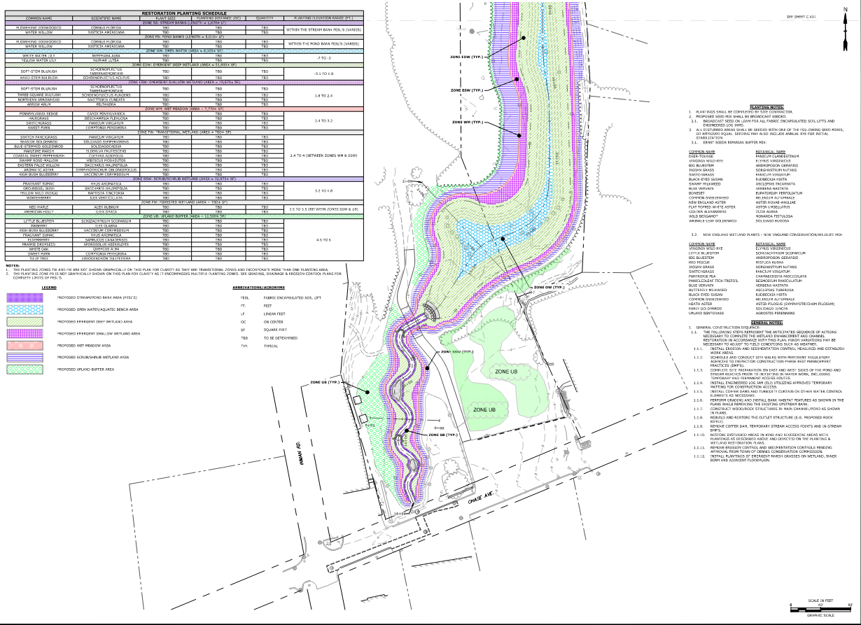
Planting Plan

Slide 18
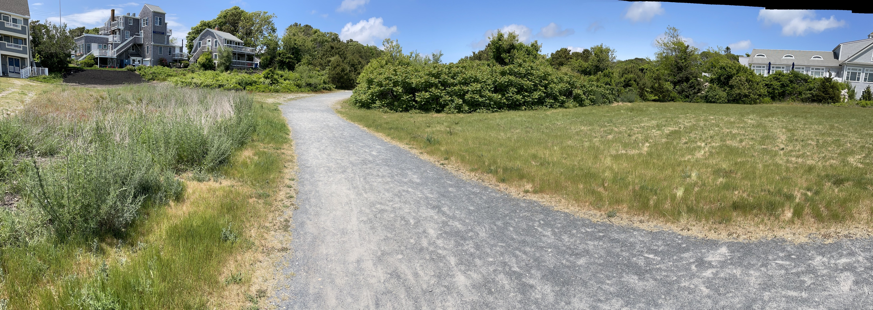
Alternative Ameneties

Slide 19
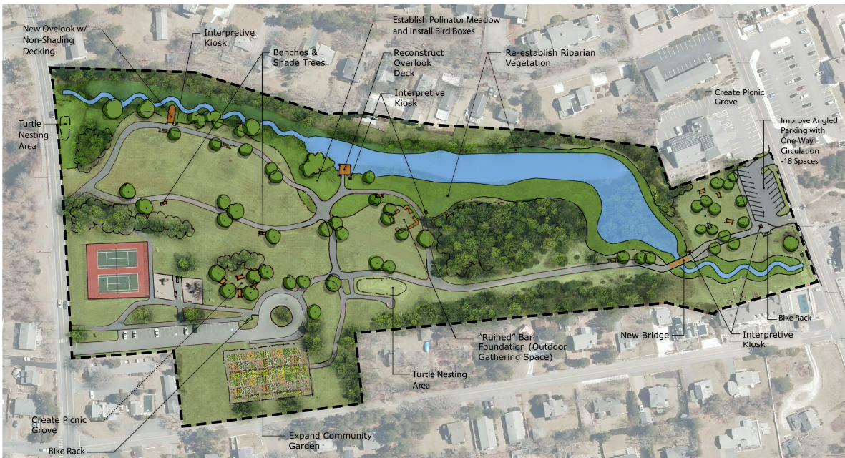

Slide 20
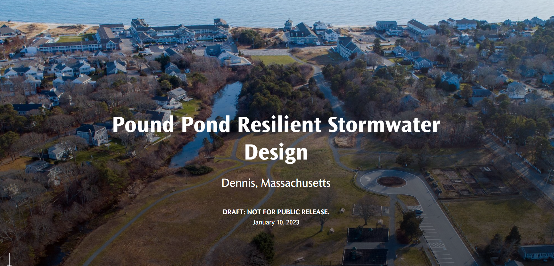
GIS Story Map Development
https://storymaps.arcgis.com/stories/d0de2d8415524bb5ba7b09c916da9b73

Slide 21
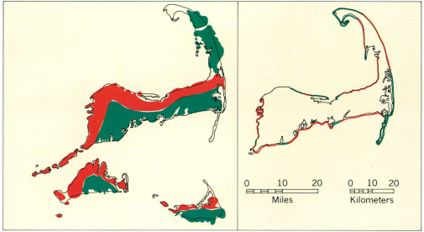
18,000 – 6,000 BC:
18,000 BC:
Pleistocene Epoch
17th Century:
Colonialization
18th Century:
Industrial Revolution
1900 – 1950:
Post World
War I
1950 – 2000:
Post World
War II
2000s:
New Millenium Era
2010s and 2020s
Present Day
Glaciation forms the Harwich Outwash Plain, outwash streams, and lakebed deposits. Marine erosion and sea level rise cut off stream connection to the ocean. Buried peat creates marshes and bogs in vicinity of what we currently know as Lower County Road and Sea View Park .
About 6,000 years ago, before extensive wave erosion of the glacial deposits had occurred, the glacial Cape Cod probably resembled the map on the left. The present major pattern of erosion and deposition is shown on the map at the right. Red shows shoreline undergoing erosion; green shows shoreline undergoing deposition.

Slide 22

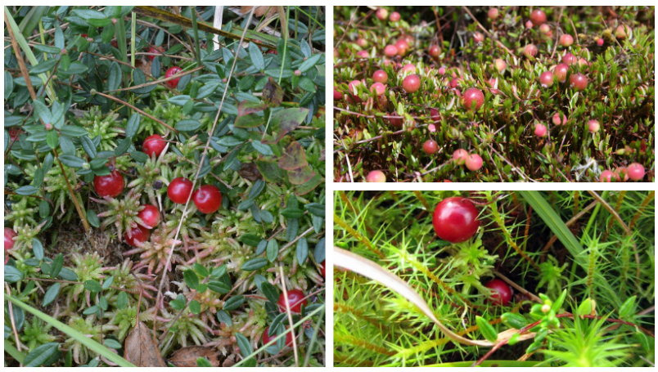
10,000 BC
People of the First Light
18,000 BC:
Pleistocene Epoch
17th Century
Colonialization
18th Century:
Industrial Revolution
1900 – 1950:
Post World
War I
1950 – 2000:
Post World
War II
2000s:
New Millenium Era
2010s and 2020s
Present Day
The ancestors of Wampanoag people have lived for at least 12,000 years on Cape Cod, pursuing a traditional economy based on fishing and agriculture.
Cranberries were native to this area and used for food, dye for textiles, and medicinal purposes to treat wounds and prevent illness.
Another way Native cultures prepare cranberries is in a caloric-rich food called pemmican, which is a mixture of tallow, dried meat, and sometimes dried berries, like cranberries.

Slide 23
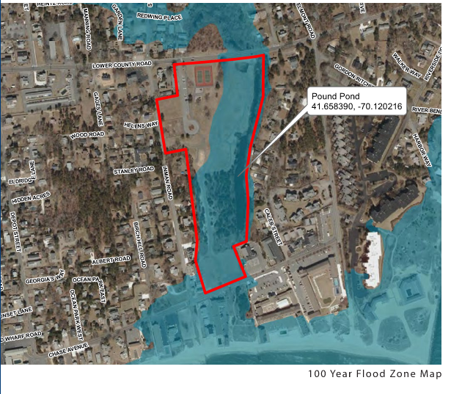
18,000 – 6,000 BC
18,000 BC:
Pleistocene Epoch
17th Century
Colonialization
18th Century:
Industrial Revolution
1900 – 1950:
Post World
War I
1950 – 2000:
Post World
War II
2000s:
New Millenium Era
2010s and 2020s
Present Day
Depressions formed by glacial meltwater created the many rivers and embayments found on the south side of Cape Cod. While the mapped flood zones perhaps suggest the pond was at one time a coastal inlet long ago, the shoreline changed significantly over the millennia removing all traces of a coastal connection. The only time a coastal connection has occurred in recent times is in instances of coastal flooding.

Slide 24
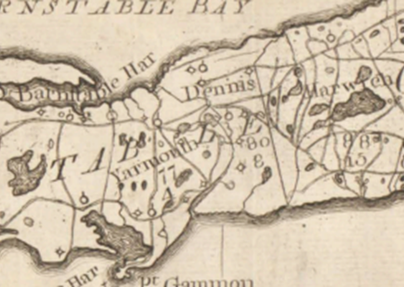
17th Century:
Colonialization
18,000 BC:
Pleistocene Epoch
17th Century
Colonialization
18th Century:
Industrial Revolution
1900 – 1950:
Post World
War I
1950 – 2000:
Post World
War II
2000s:
New Millenium Era
2010s and 2020s
Present Day
Dennisport is first settled in the 1630’s. Agriculture was the primary economy. The land was turned into open pasture and livestock grazed on common lands around a freshwater marsh known as Pound Pond. The woodlands are harvested for ship building.
1795 Massachusetts Map

Slide 25
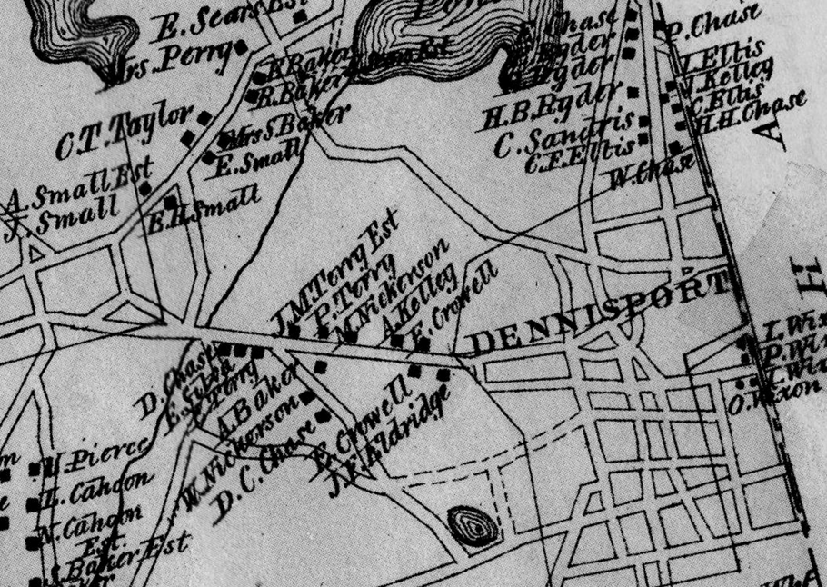
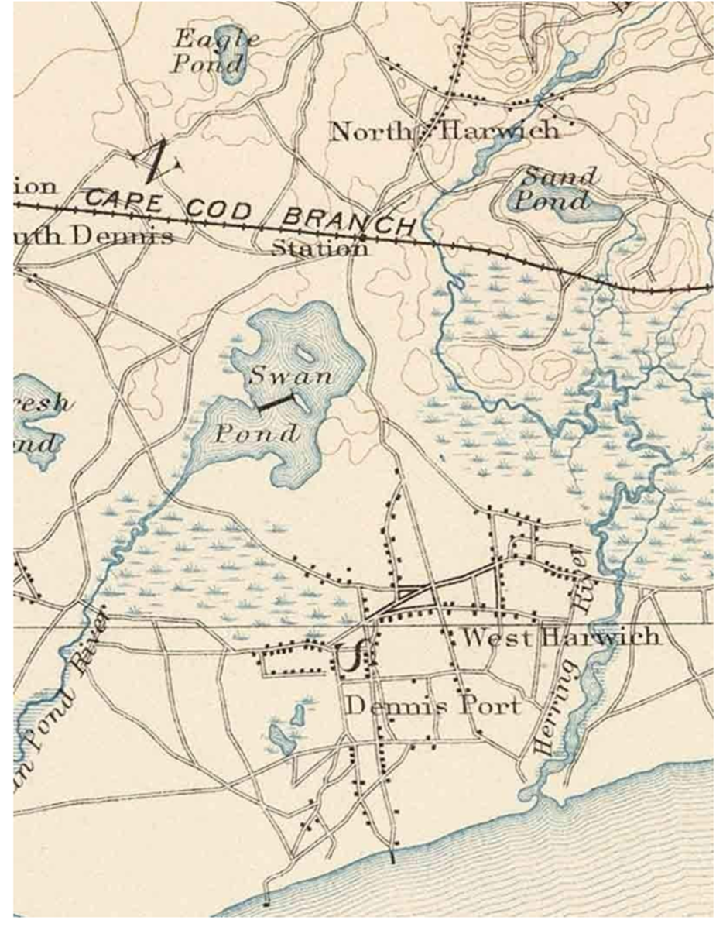
18th Century: Industrial Revolution
18,000 BC:
Pleistocene Epoch
17th Century:
Colonialization
18th Century:
Industrial Revolution
1900 – 1950:
Post World
War I
1950 – 2000:
Post World
War II
2000s:
New Millenium Era
2010s and 2020s
Present Day
The cranberry industry in Dennis develops, and the bog near Pound Pond is cultivated. Ditches are dug to control water for cranberry harvests. Pound Pond is used as a water supply for agriculture use in the summer, and as a skating pond in the winter. Drainage extends to Nantucket Sound and locally called Pound Pond Creek. Wharfs are constructed to support maritime industry and a mackerel canning factory is built at the foot of Depot Street in 1850.
1880 Atlas of Barnstable County
1890 USGS Topo Map

Slide 26
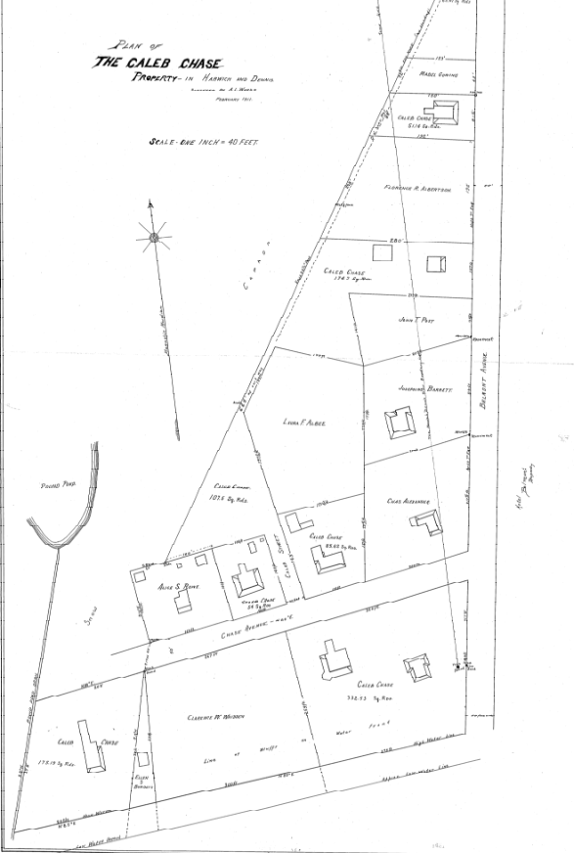
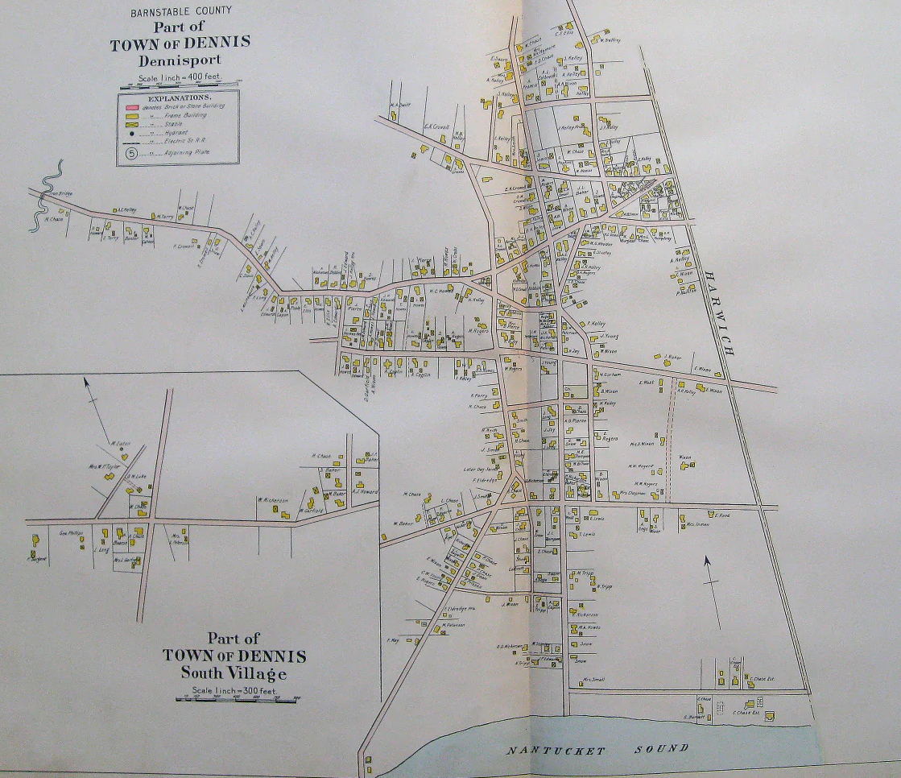
1900 – 1950:
Post World War I
18,000 BC:
Pleistocene Epoch
17th Century
Colonialization
18th Century:
Industrial Revolution
1900 – 1950:
Post World
War I
1950 – 2000:
Post World
War II
2000s:
New Millenium Era
2010s and 2020s
Present Day
After WWI, the land is sold, and the Finnegan Family establishes a dairy farm. The bog operation continues but is eventually abandoned around 1930. The Pound Pond drainage ditch, is shown in the 1912 plan to the right. The ditch is moved to its present location in the 1950s and a tide gate installed to prevent flooding at Inman Road.
This 1906 hand-colored map shows the location of the Chase Family properties on Chase Road, and the area where Pound Pond is today near the north arrow. The dashed road is Summer Street, and Inman Road was extended to the south. The present-day outfall is located at the end of Inman Road.

Slide 27
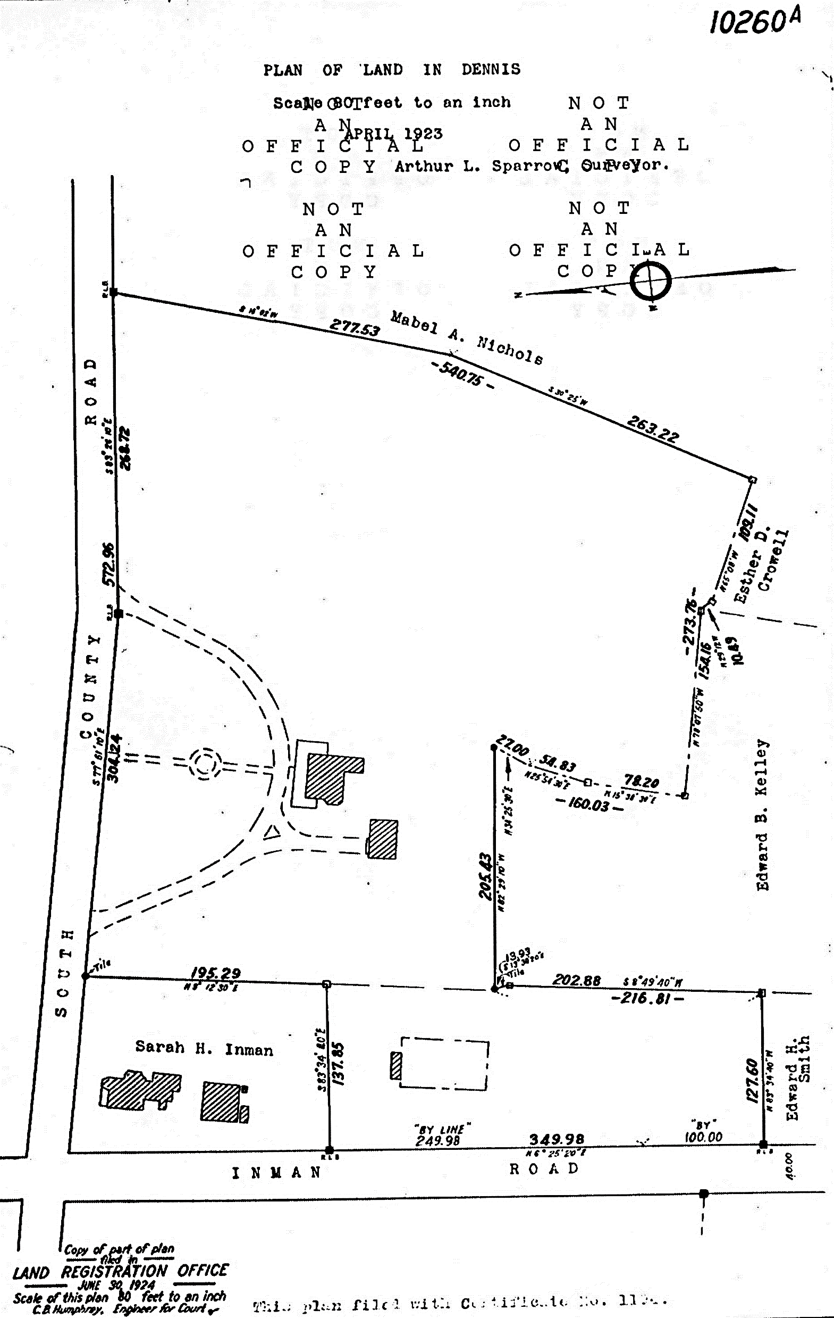
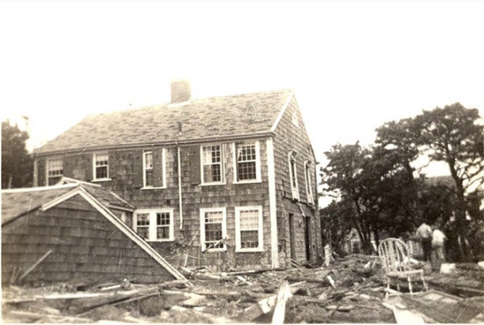
1900 – 1950:
Post World War I
18,000 BC:
Pleistocene Epoch
17th Century
Colonialization
18th Century:
Industrial Revolution
1900 – 1950:
Post World
War I
1950 – 2000:
Post World
War II
2000s:
New Millenium Era
2010s and 2020s
Present Day
This 1924 plan to the right shows Finnegan’s Farm including the barn and House. The extent of the flooding from the hurricane in 1944 can be estimated from the 100-year floodplain outline in blue.
The Finnegan’s field was flooded, drowning cows, and severely damaging homes in its path as shown in the example above.

Slide 28
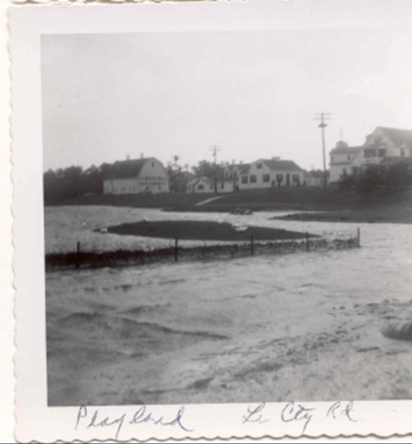
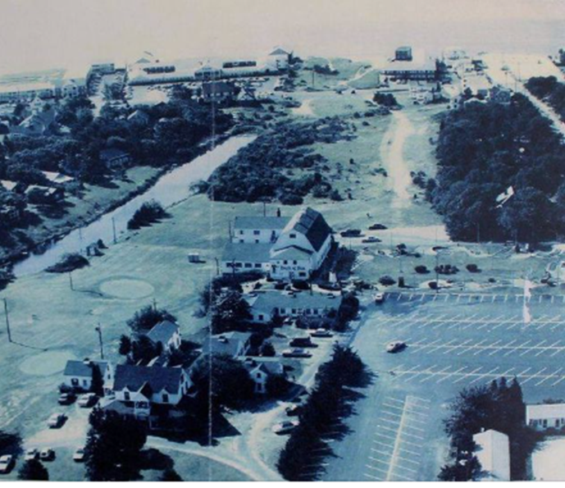
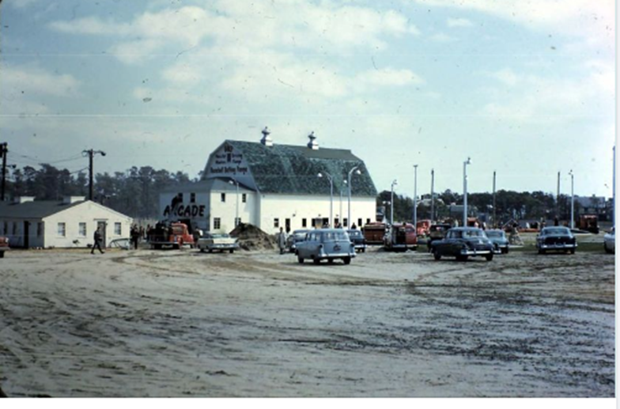
1950 – 2000: Industrial Revolution
18,000 BC:
Pleistocene Epoch
17th Century:
Colonialization
18th Century:
Industrial Revolution
1900 – 1950:
Post World
War I
1950 – 2000:
Post World
War II
2000s:
New Millenium Era
2010s and 2020s
Present Day
The dairy operation is discontinued, and the barn and buildings are converted into a tourism location know as the Sea View Playland. The original Finnegan Ban is converted to the “Barn of Fun”. Pound Pond is dredged for a water feature and a water control structure is added to support paddle boats and a water hazard for miniature golf.
Above, view from Lower County Road of Seaview Playland flooding in 1954 Hurricane Carol. The pond is to the right and the barn and Playland buildings are at the top of the photo.

Slide 29
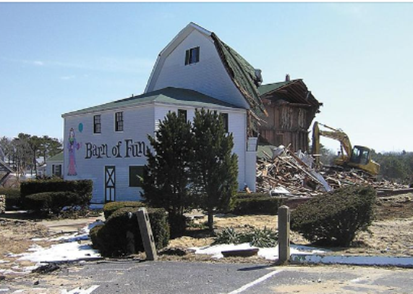
2000s:
New Millenium Era
18,000 BC:
Pleistocene Epoch
17th Century
Colonialization
18th Century:
Industrial Revolution
1900 – 1950:
Post World
War I
1950 – 2000:
Post World
War II
2000s:
New Millenium Era
2010s and 2020s
Present Day
Seaview Playland is sold to the Town of Dennis in 2004 for conversion to a recreational Park. The Town receives grant funding for Seaview Park and builds amenities including walking trails, community gardens, and tennis courts. Pound Pond is cited as problematic due to heavy nutrient pollution and mosquitoes.

Slide 30

Present Day
18,000 BC:
Pleistocene Epoch
17th Century:
Colonialization
18th Century:
Industrial Revolution
1900 – 1950:
Post World
War I
1950 – 2000:
Post World
War II
2000s:
New Millenium Era
Present Day
In 2015, the Town of Dennis starts exploring options for the restoration of Pound Pond to improve ecological function and improve water quality.
In 2021, Dennis receives MVP grant funding to design and permit a restoration plan.

Slide 31
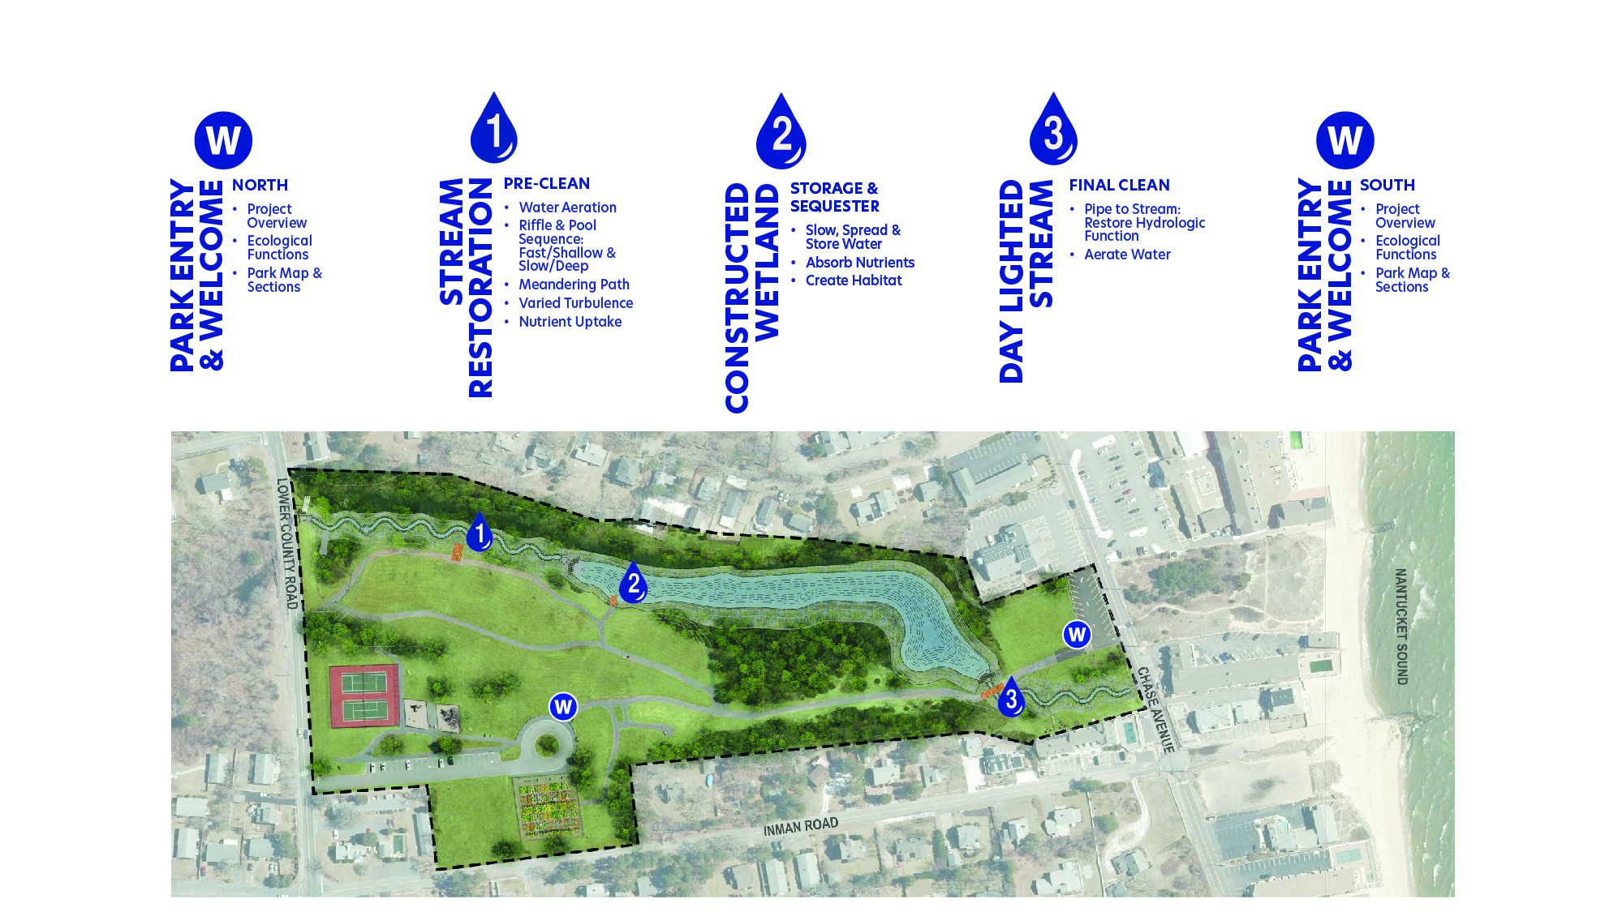
Kiosk Locations

Slide 32
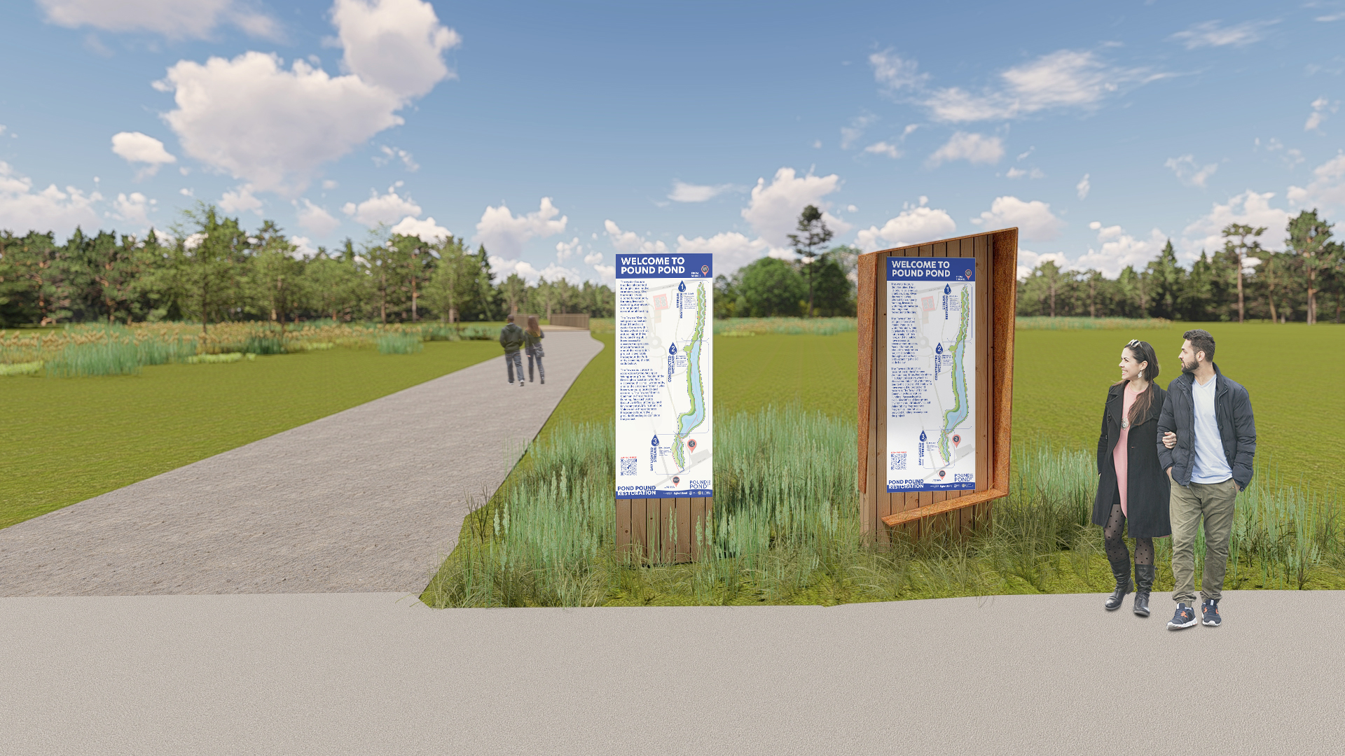
Park Entry
Concept 1: Timber Framed
Concept 2: Timber Framed & Corten Steel Accent Wrap

Slide 33
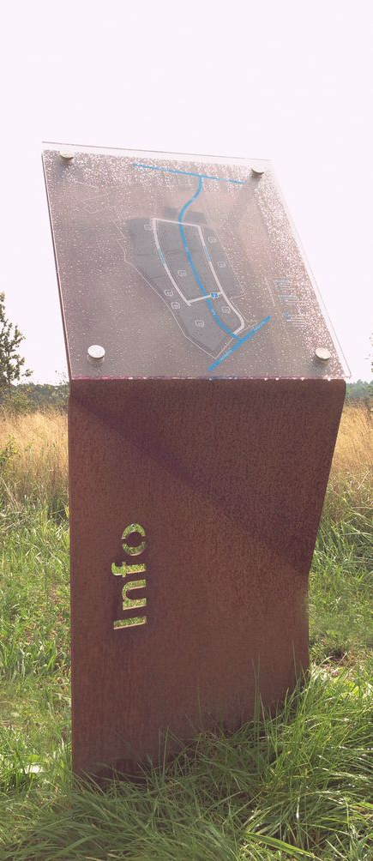
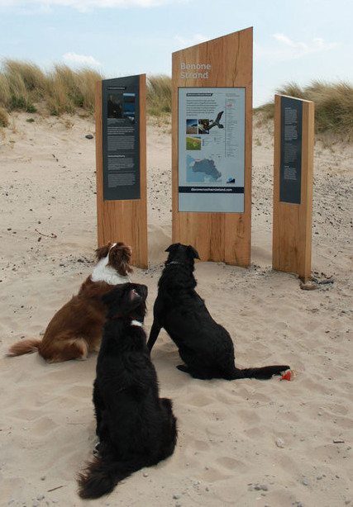
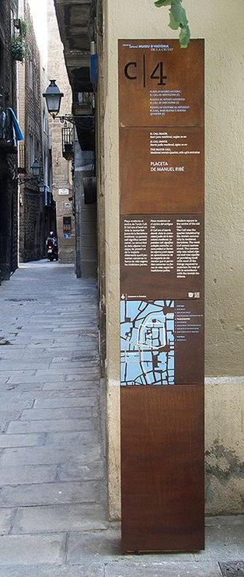
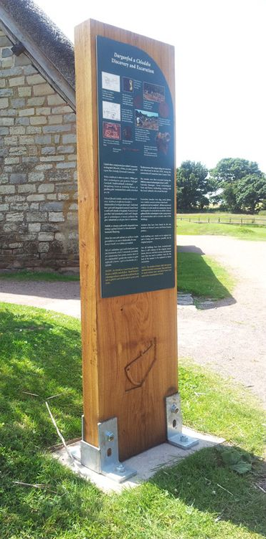
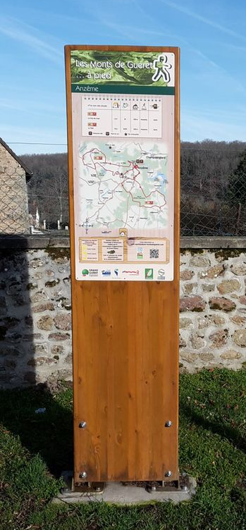
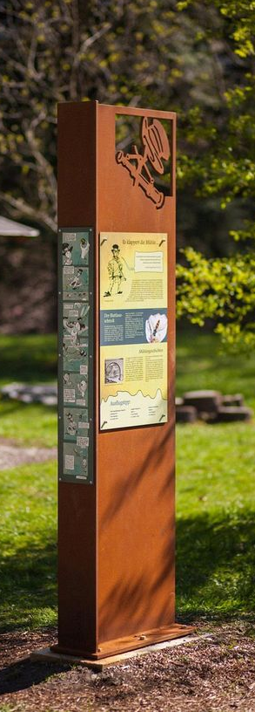
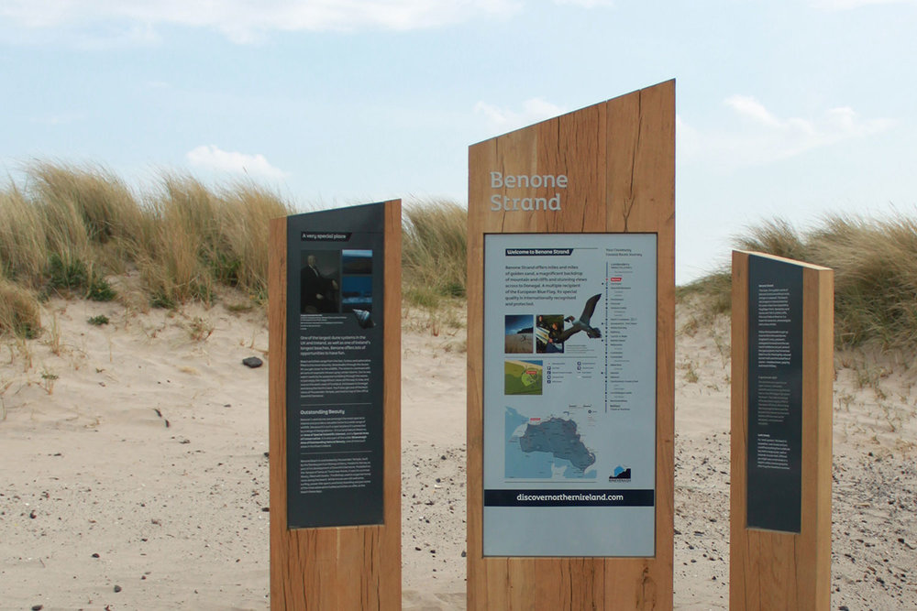
Park Entry – Construction Concepts
Timber
Corten steel accent
Timber with angled top edge

Slide 34



Park Entry
North Parking Lot
South Parking Lot

Slide 35

Daylighted Stream

Slide 36

Daylighted Stream

Slide 37

Constructed Wetland

Slide 38

Constructed Wetland

Slide 39

Stream Restoration

Slide 40

Stream Restoration

Slide 41

Plant ID Posts

Slide 42




Plant ID Posts

Slide 43


Notes:
The plan, annual reports and deliverables from the first 4 years is available on the Town Website.
Any questions?

